Slide 1


Heart Disease Prevention
SAS Business Project
PRESENTED BY: LATHA MATHEW METRO COLLEGE OF TECHNOLOGY
PROJECT GUIDE: MR. AR KAR MIN, MPH,MMA
DATE: 26 JULY, 2021

Slide 2
Outline
Introduction
Background
Objective
Methodology
Conceptual Framework
Descriptive Analysis
Inferential Statistics
Findings & Conclusions
Recommendations
Appendix

Slide 3
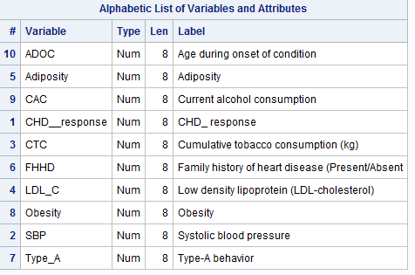
Introduction
The Project Dataset, provided by Metro College of Technology, is taken from a larger dataset, described in Rousseauw et al, 1983, South African Medical Journal.
Many of the CHD positive men have undergone blood pressure reduction treatment and other programs to reduce their risk factors after their occurrence of CHD.
This dataset is a collection of data of patients that had Coronary Heart Disease with several risk factors.
The dataset consists of 462 observations and 10 variables which are all Numeric. The variables are listed in the table below.
The study of the Dataset aims at Descriptive Analysis and Modeling of the factors that increase the risk of heart disease.
It also looks to analyze medical data in understanding patterns and relationships associated with heart disease from a historical heart disease database.

Slide 4
Background
Heart disease, alternatively known as cardiovascular disease, impact the heart and is the primary basis of death worldwide over the span of the past few decades.
Coronary heart disease develops when the major blood vessels that supply your heart with blood, oxygen and nutrients (coronary arteries) become damaged or diseased. Several factors such as blood pressure, anxiety, cholesterol, diabetes, obesity, smoking, alcohol consumption, lack of physical activities, family history of heart disease increase the risk of heart disease.
Medical communities attempt to find a way for the accurate and timely prediction of CHD by using new statistical techniques, such as data mining. By extracting useful data and discovering knowledge from the large volume of medical data, heart disease can be identified and physicians can be equipped with valuable information for better decision making.
These techniques also help to recognize the patterns and factors influencing heart disease and make intelligent clinical decisions in prevention and management of the disease.

Slide 5
Objectives
Main objective - To prevent or reduce the risk of developing Coronary Heart Disease
To identify patterns and Associations of risk factors , modifiable and non-modifiable such as Family History of heart disease, Systolic blood Pressure , LDL cholesterol associated to CHD
To find which are the most and least significant attributes that helps in predicting whether a person is having CHD risk or not.

Slide 6
Methodology
Data Collection – The data is provided by Metro College.
Data Definition – The Dataset contains 10 variables, namely- Age during onset of condition (ADOC), Obesity, Family history of heart disease (Present/Absent) (FHHD), Type-A behavior(Type_A), Systolic Blood Pressure (SBP), Cumulative Tobacco consumption (CTC), Low density lipoprotein (LDL-cholesterol) (LDL_C), Current alcohol consumption ( CAC), and CHD response (Yes/No) (CHD_response).
The Target Variable or “Y variable" identified is CHD_response.
Out of the 10 variables, the variables, CHD_response and FHHD were transformed to categorical for Bivariate Analysis respectively.
Data Validation (Missing Values and Outliers)- SAS procedures were used to find missing values and Outliers.
Inclusion/Exclusion –All variables in the dataset are included for the Analysis.
Software Used – SAS 9.4
Statistical Methods/Techniques used- Chisquare, test, T-test, Logistic Regression

Slide 7
Conceptual Framework
Independent Variables
Dependent Variable/Target Variable
CHD response ( Risk/No Risk)
Age during onset of condition (ADOC)
Obesity
Family history of heart disease (Present/Absent) (FHHD)
Type-A behavior(Type_A)
Systolic Blood Pressure(SBP)
Cumulative Tobacco consumption(CTC)
Low density lipoprotein (LDL-cholesterol) (LDL_C)
Current alcohol consumption( CAC)

Slide 8
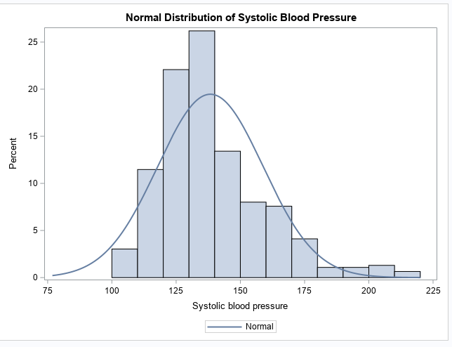
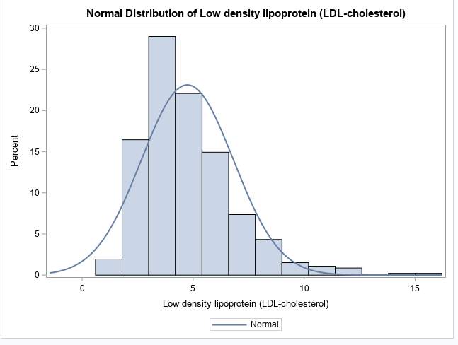
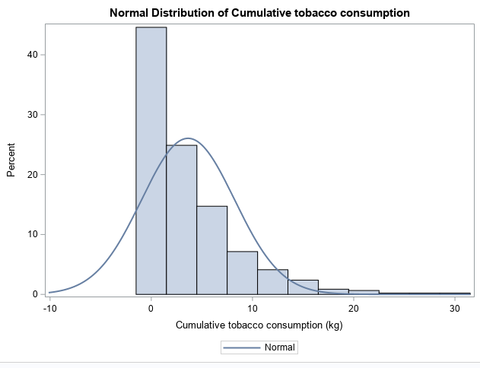
Univariate Analysis of ‘X’ variables
Univariate Analysis of the Independent variables show that they are normally distributed. We can observe that each of the variables have a near normal distribution. This will allow us to use parametric statistics later that require normality as a prerequisite.
The variables chosen are Systolic Blood Pressure, Cumulative tobacco consumption, Low density lipoprotein (LDL-cholesterol), Adiposity, Type-A behavior, Obesity, Current alcohol consumption, Age during onset of condition.

Slide 9
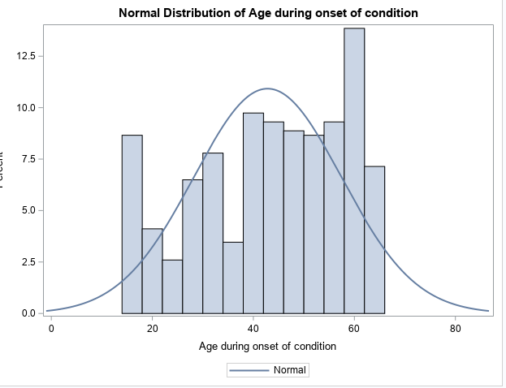
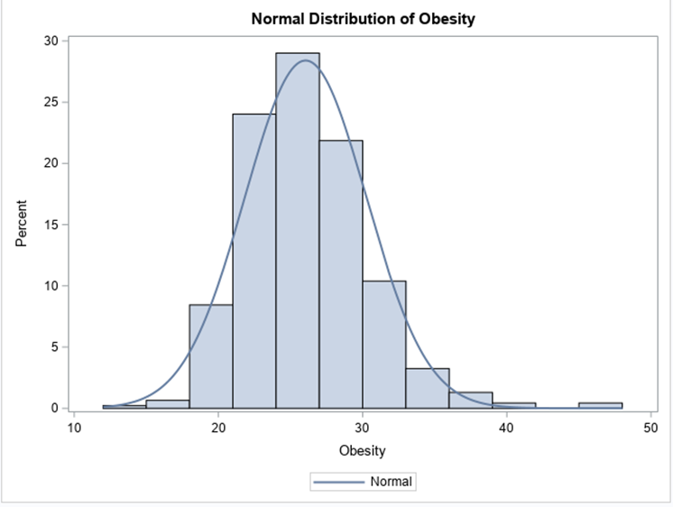
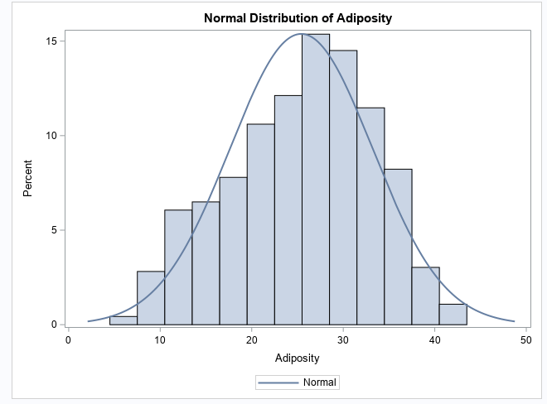
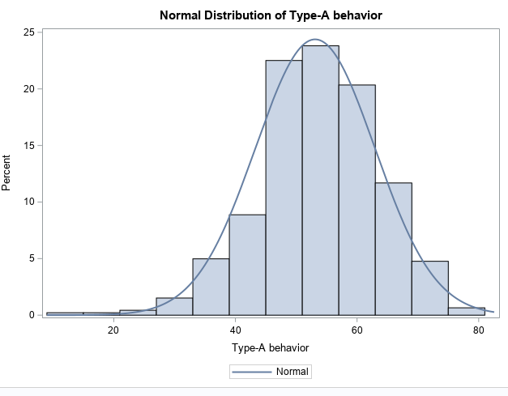
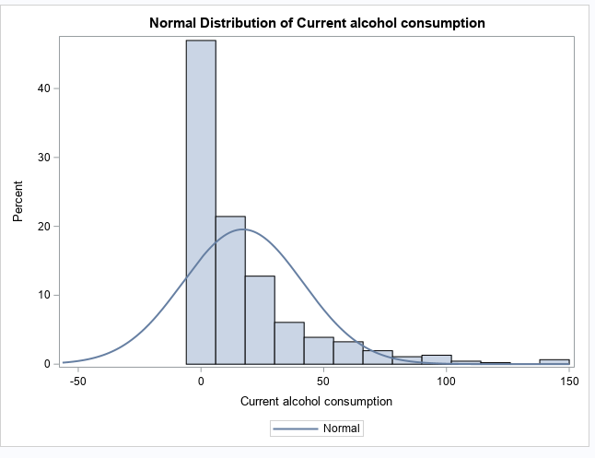
Univariate Analysis of Independent ‘X’ Variables

Slide 10
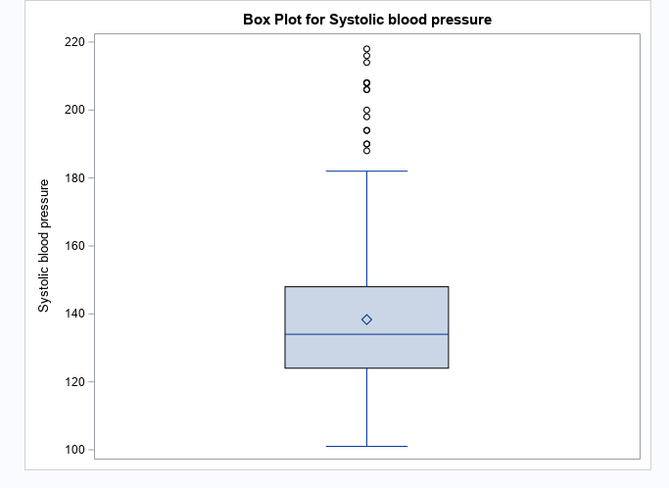
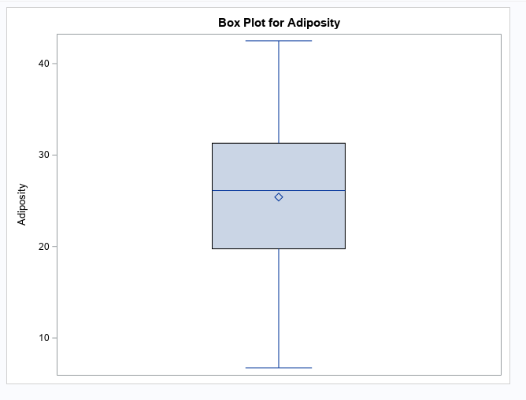
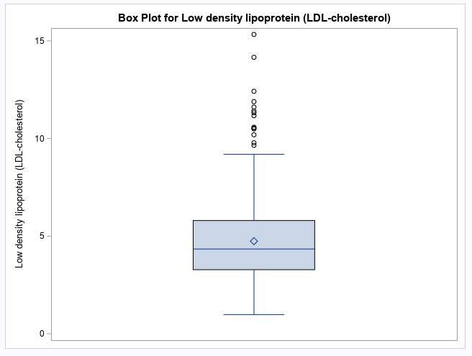
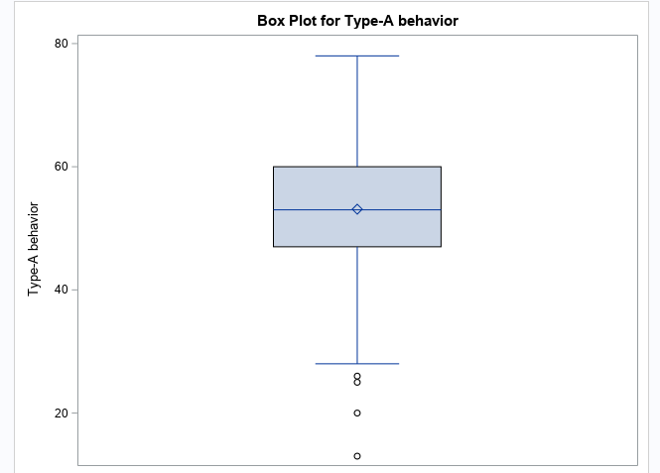
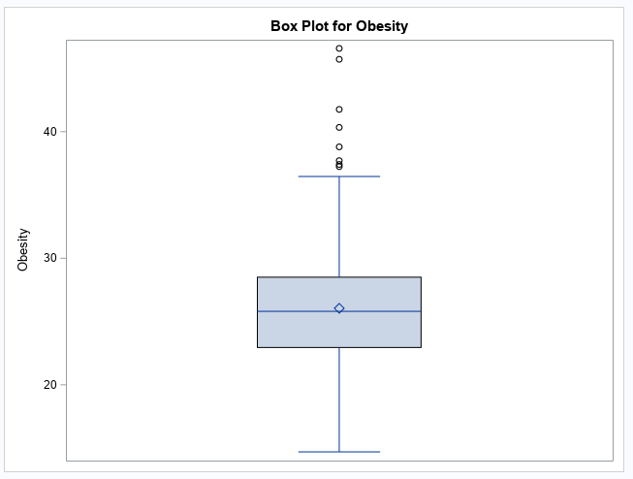
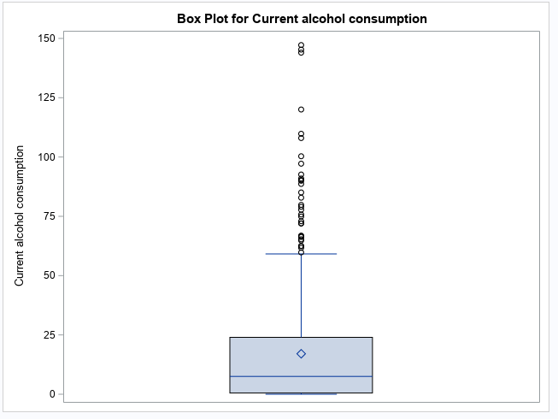
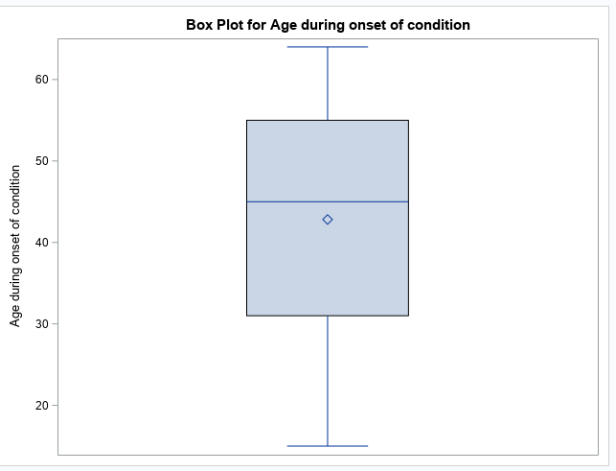
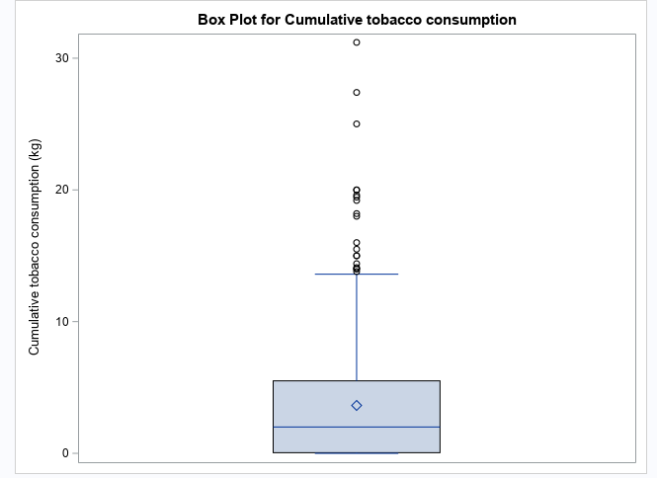
Univariate Analysis of the Numerical Variables
Chosen Variables
SBP
CTC
LDL_C
Adiposity
Type_A
Obesity
CAC
ADOC;
Outliers were detected for SBP, LDL_C, CTC, CAC, Obesity and Type_A. No outliers detected for ADOC, Adiposity.
The box plot also known as the schematic plot, as you know appears behind the stem-and-leaf plot. Here we have a visual summary of the data and the outliers identified.
The bottom and top edges of the box correspond to the 25th (Q1) and 75th (Q3) percentiles. The box length is one interquartile range (Q3-Q1)
Values that we see farther away are the potential outliers.

Slide 11
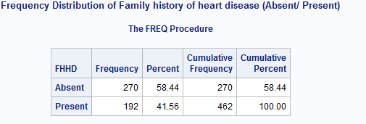
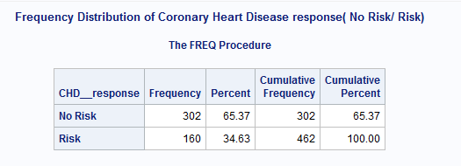
Frequency Distribution of Categorical Variables
Categorical variables chosen are Family history of Heart Disease and Coronary Heart Disease Response which are summarized in the table below.
Categorical variables can be summarized using a frequency table, which shows the number and percentage of cases observed for each category of a variable. PROC FREQ procedure can count unique values for either character or numeric
variables . In addition, it also reports the frequency of missing values

Slide 12
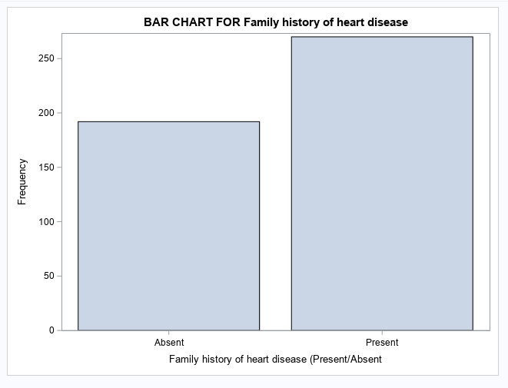
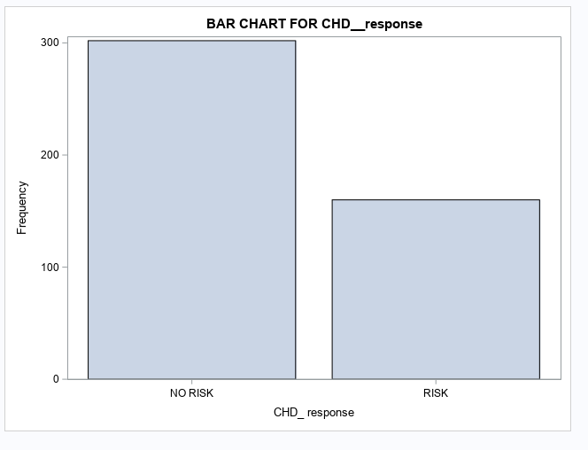
Univariate Analysis of Categorical variables
SAS bar chart shows the distribution of a categorical variable, the variables below are Family History of heart disease and Coronary Heart Disease Response. Here, the bars have been divided into groups using the GROUP= option.

Slide 13
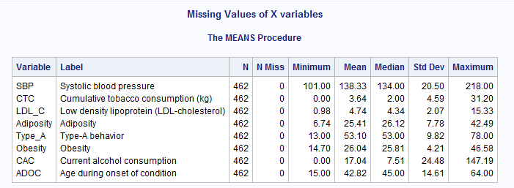
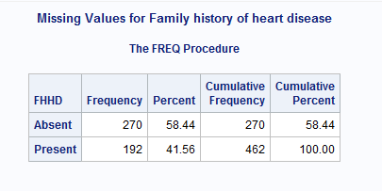
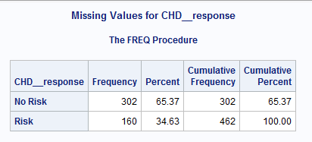
Missing Values of Numerical & Categorical Variables
There is no missing values found for Numerical Variables
There is no missing values found for Categorical Variables
Numeric missing values are represented by a single period (.)
Character missing values are represented by a single blank enclosed in quotes (' ').As a general rule, SAS procedures that perform computations handle missing data by omitting the missing values.
SAS treats missing values as a very valid value and provides powerful functions that enable great control over their processing.

Slide 14
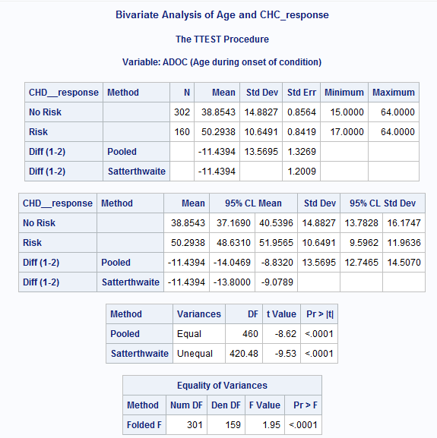
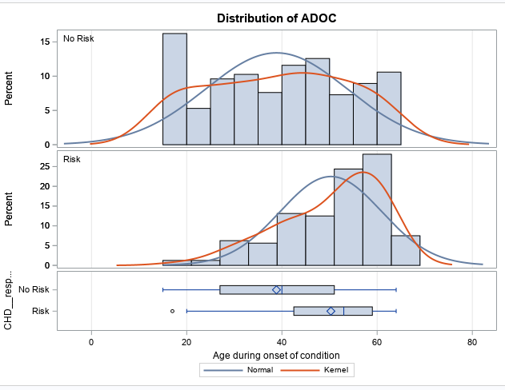
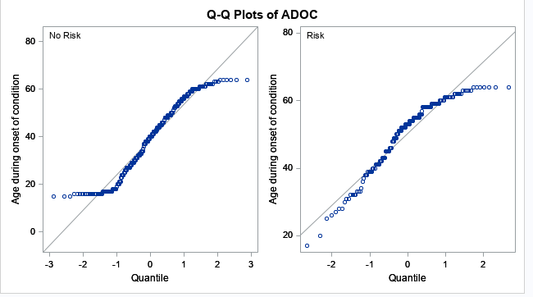
Bivariate Analysis of Age & Coronary Heart Disease Response
The t-test is used to compare the means of two groups on a given variable. It is used when one variable is of a continuous nature and the other is dichotomous.
Here, we have used T-test procedure for analysis of Age & Coronary Heart Disease Response.
P value is less than 0.0001

Slide 15
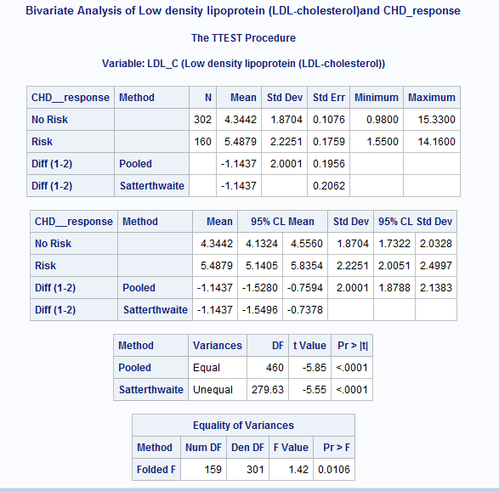
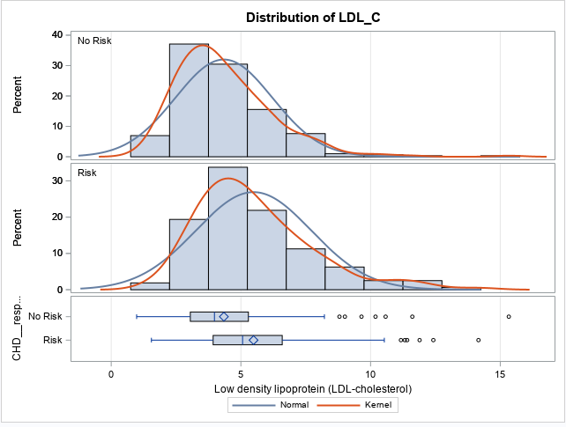
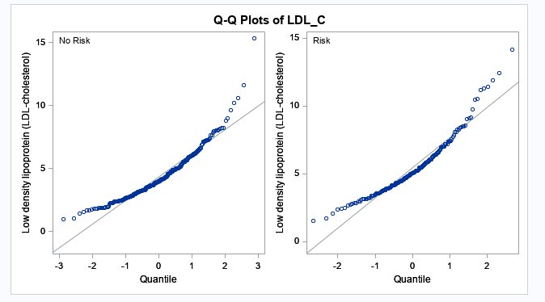
Bivariate Analysis of LDL- Cholesterol & Coronary Heart Disease Response
The t-test is used to compare the means of two groups on a given variable. It is used when one variable is of a continuous nature and the other is dichotomous.
Here, we have used T-test procedure for analysis of LDL- Cholesterol & Coronary Heart Disease Response.
P value is 0.0106

Slide 16
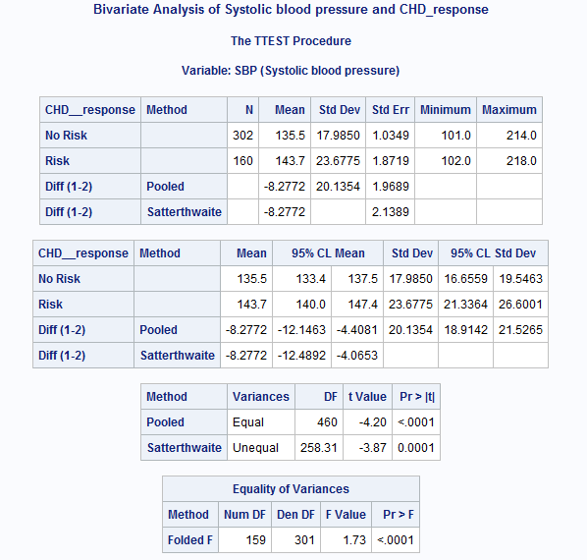
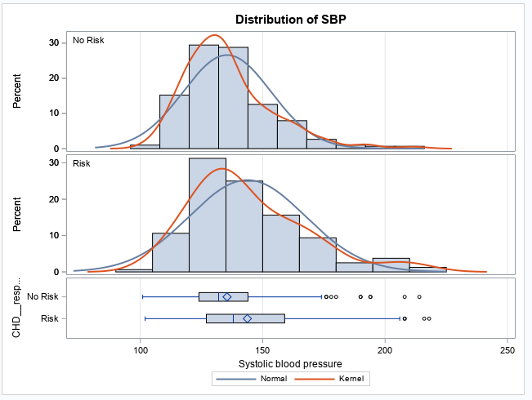
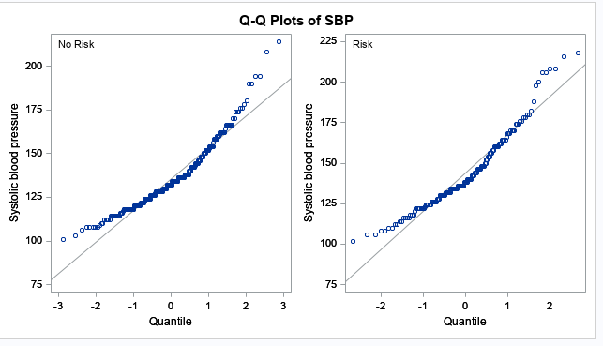
Bivariate Analysis of Systolic Blood Pressure & Coronary Heart Disease
The t-test is used to compare the means of two groups on a given variable. It is used when one variable is of a continuous nature and the other is dichotomous.
Here, we have used T-test procedure for analysis of Systolic Blood Pressure & Coronary Heart Disease response.
P value is less than 0.0001

Slide 17
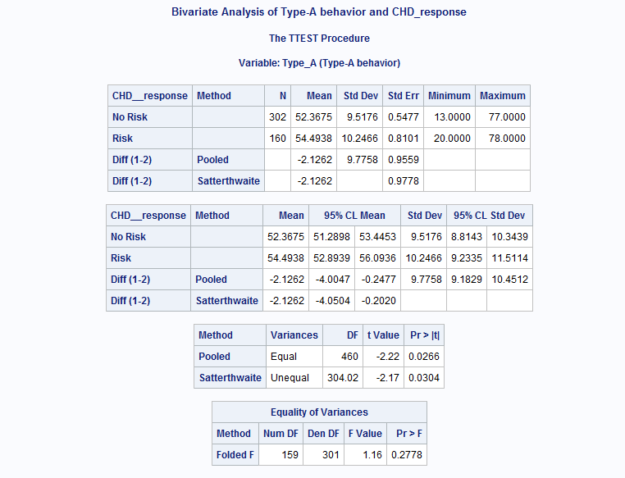
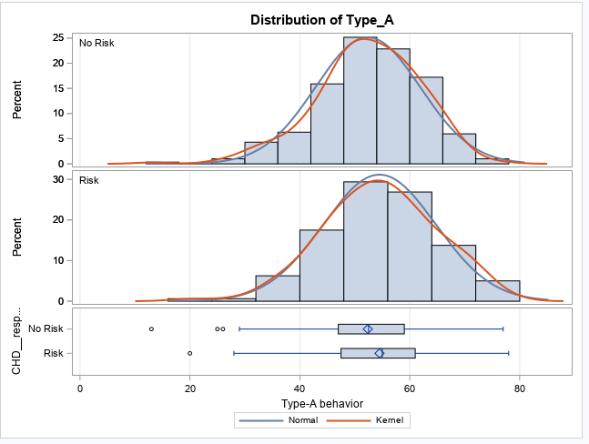
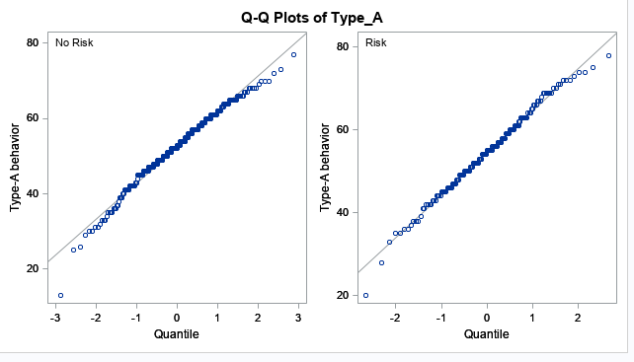
Bivariate Analysis of Type A Behaviour & Coronary Heart Disease
The t-test is used to compare the means of two groups on a given variable. It is used when one variable is of a continuous nature and the other is dichotomous.
Here, we have used T-test procedure for analysis of Type A Behaviour & Coronary Heart Disease.
P value is 0.2778

Slide 18
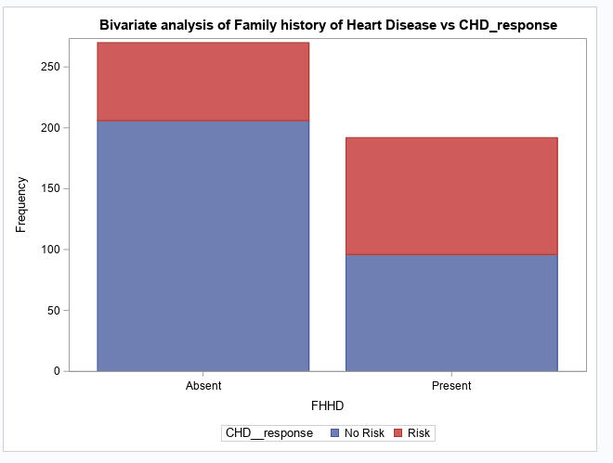
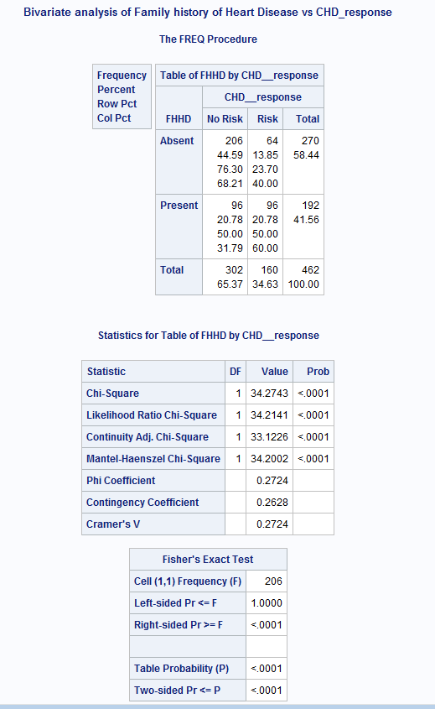
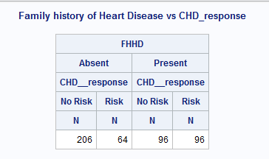
Bivariate Analysis of Family History of Heart Disease & Coronary Heart Disease Response
A chi-square test is used to examine the association between two categorical variables. It can be used to test both extent of dependence and extent of independence between Variables. SAS uses PROC FREQ along with the option chisq to determine the result of Chi-Square test.
P value is less than 0.0001

Slide 19
Hypothesis Testing for Age & Coronary Heart Disease Response
IF P < 0.05 , REJECT H0
IF P > 0.05 , NOT REJECT H0
H0 : There is no relationship between Age & Coronary Heart Disease Response
HA : There is a relationship between Age & Coronary Heart Disease Response
Conclusion : HA : Based on the values derived, there is Relationship between Age & Coronary Heart Disease response, as P value is less than 0.0001 which is less than 0.05.

Slide 20
Hypothesis Testing for LDL- Cholesterol & Coronary Heart Disease Response
IF P < 0.05 , REJECT H0
IF P > 0.05 , NOT REJECT H0
H0 : There is no relationship between LDL- Cholesterol & Coronary Heart Disease Response
HA : There is a relationship between LDL- Cholesterol & Coronary Heart Disease Response
Conclusion : HA: Based on the values derived, there is Relationship between LDL- Cholesterol & Coronary Heart Disease Response, since P value is 0.0106 which is less than 0.05

Slide 21
Hypothesis Testing for Systolic Blood Pressure & Coronary Heart Disease Response
IF P < 0.05 , REJECT H0
IF P > 0.05 , NOT REJECT H0
H0 : There is no relationship between Systolic Blood Pressure & Coronary Heart Disease Response
HA : There is a relationship between Systolic Blood Pressure & Coronary Heart Disease Response.
Conclusion : HA : Based on the derived values, there is Relationship between Systolic Blood Pressure & Coronary Heart Disease Response as P value is less than 0.0001 which is less than 0.05.

Slide 22
Hypothesis Testing for Type A_behaviour & Coronary Heart Disease Response
IF P < 0.05 , REJECT H0
IF P > 0.05 , NOT REJECT H0
H0 : There is no relationship between Type A_behaviour & Coronary Heart Disease Response
HA : There is a relationship between Type A_behaviour & Coronary Heart Disease Response
Conclusion : H0 : Based on the values derived, there is no Relationship between Type A_behaviour & Coronary Heart Disease Response, since the P value = 0.2778 which is greater than 0.05

Slide 23
Hypothesis Testing for Family History of Heart Disease & Coronary Heart Disease Response
IF P < 0.05 , REJECT H0
IF P > 0.05 , NOT REJECT H0
H0 : There is no relationship between Family History of Heart Disease & Coronary Heart Disease Response
HA : There is a relationship between Family History of Heart Disease & Coronary Heart Disease Response
Conclusion : HA : based on the values derived, there is Relationship between Family History of Heart Disease & Coronary Heart Disease Response, since P value is less than 0.0001, which is less than 0.05

Slide 24
Outlier treatment of Numerical variables
Outliers for each numerical variables were removed and created a final dataset without outliers.
Used macro for removal of the outliers, created temporary tables for each variables, and then merged the tables to get the final dataset
Following number of outliers were removed from the variables:
Obesity (20)
SBP (32)
CTC (40)
LDL_C (19)
Adiposity (3)
Type_A (12)
CAC (39)
ADOC (0)

Slide 25
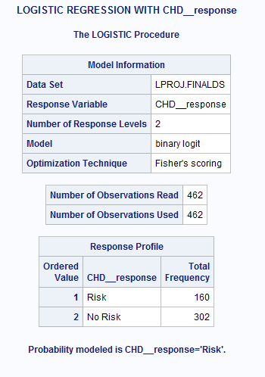
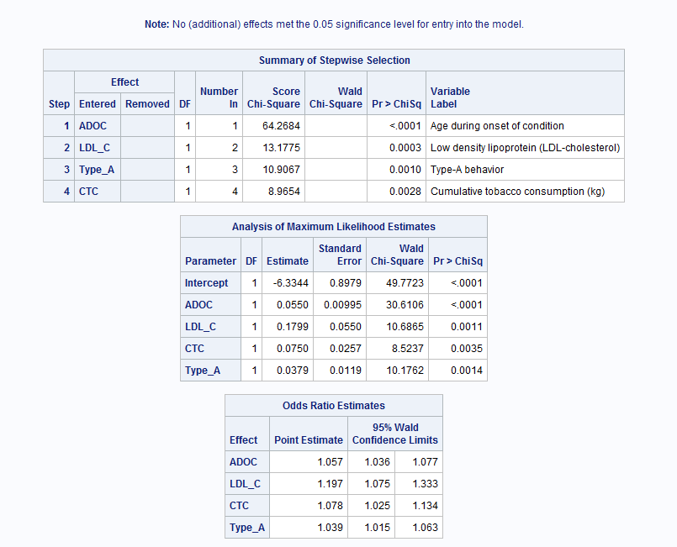
Modeling - Logistic Regression of Coronary Heart Disease Response
Logistic Regression is used to predict the probability of a categorical dependent variable. The dependent variable here is Coronary Heart Disease Response ,is a binary variable classified as ‘Risk’ and ‘No Risk’.

Slide 26
Findings & Conclusions
Based on the Logistic Regression analysis for CHD_response with the 8 variables- the output from the Model predicts the variables Age during Onset of condition, LDL-Cholesterol ,CTC and Type A Behavior to have greater impact on the Coronary Heart Disease.
The p-values for the dependent variables are found to be less than 5 %, which means that there is significant association between the Risk factors and Coronary heart disease response.
As per the model, it predicts the probability of ‘Risk’ for Coronary Heart Disease response as 160 people were modelled to have ‘Risk ‘and 302 people modelled to have ‘No risk’.
From the Analysis of Maximum Likelihood Estimates, Age, LDL -Cholesterol , Cumulative tobacco consumption and Type A behavior were found to be the most significant predictors associated to CHD risk.
Other predictor variables like Systolic blood pressure, Obesity, Adiposity , Cumulative Alcohol consumption used for modelling were not considered to be at significant levels, hence no associations of these variables with the Target variable, Coronary Heart disease could be established.
This Model is most effective in predicting binary outcome based on multiple predictor variables.

Slide 27
Recommendations
Age is a non-modifiable risk factor which cannot be controlled. People older than age 65 are more likely to have CAD as the risk of CHD increases with age. This is because plaque builds up over time.
Anyone over the age of 40 should see their physician for a free cardiovascular risk assessment to find out their risk of getting coronary heart disease, having a heart attack or having a stroke. This is called a heart health assessment or a heart health risk assessment. Regular screening and assessment are helpful in managing and prevention of the risk of CHD.
Tobacco Consumption Reduction techniques are recommended like those of
Monitoring tobacco use
Implementing tobacco prevention policies such as Offering help to quit tobacco use, Warn about the dangers of tobacco, Enforce bans on tobacco
protecting people from tobacco use through education and awareness programs in schools and in the community by advertising, promotion
Type A behavior, another non-modifiable risk factor cannot be controlled, where Type A individuals are characterized by excessive achievement striving, time urgency and hostility.
Recognition of the trait, by the person affected, Advice on lowering the bar, open communication , avoiding situations that trigger stress are some of the ways to manage Type A behavior.
Implementation of Health promotion programs aimed at reduction of LDL- Cholesterol.
Eating a heart-healthy diet which includes one on one meeting of the patients with the Dietitian, encourage them for revision of menus like consuming more fiber — especially soluble fiber found in fruits, beans and oats can help reduce LDL cholesterol levels and cutting back on fried foods, desserts, processed meats.
Exercise regularly, maintain a healthy weight, encourage patients to join community health centers to enroll in exercise programs aimed at cholesterol reduction programs specifically.
Drug Therapy like Lipid-lowering therapy with statins reduces relative cardiovascular risk by approximately 20 to 30 percent as recommended by physicians for patients with CVD.
Regular screening with the physician can also help to keep LDL- Cholesterol levels in check as well.
In other words, reducing the risk or prevention of Coronary Heart Disease starts with smart choices that place importance on lifestyle changes with specific, realistic and achievable goals for effective management of both modifiable and non-modifiable risk factors.

Slide 28
Appendix- SAS Scripts
libname LProj "C:\SAS\SAS-BusinessProjects\Heart_Disease_Prediction";
PROC IMPORT OUT= LProj.HEART_DATA1B
DATAFILE= "C:\SAS\SAS-BusinessProjects\Heart_Disease_Prediction\Heart Disease data.xlsx"
DBMS=EXCEL REPLACE;
RANGE="'Heart data$'";
GETNAMES=YES;
MIXED=NO;
SCANTEXT=NO;
USEDATE=NO;
SCANTIME=NO;
RUN;
PROC CONTENTS DATA = LProj.HEART_DATA1B;
RUN;
PROC CONTENTS DATA =LProj.HEART_DATA1B VARNUM SHORT;
RUN;
PROC SQL;
CREATE TABLE LProj.HD1B1 AS
SELECT CHD__response,
SBP"Systolic blood pressure",
CTC"Cumulative tobacco consumption (kg)",
LDL_C"Low density lipoprotein (LDL-cholesterol)",
Adiposity,
FHHD"Family history of heart disease (Present/Absent",
Type_A"Type-A behavior",
Obesity,
CAC"Current alcohol consumption",
ADOC "Age during onset of condition"
FROM LProj.HEART_DATA1B
;
QUIT;
PROC CONTENTS DATA= LProj.HD1B1;
RUN;

Slide 29
Appendix
DATA LProj.HD1B5;
SET LProj.HD1B1;
IF CHD__response EQ 1 THEN CHD_Cat ="No Risk";
ELSE IF CHD__response EQ 2 THEN CHD_Cat ="Risk";
IF FHHD EQ 1 THEN FHHD_Cat ="Present";
ELSE IF FHHD EQ 2 THEN FHHD_Cat ="Absent";
drop CHD__response;rename CHD_cat= CHD__response;
drop FHHD;rename FHHD_Cat= FHHD; RUN;
PROC UNIVARIATE DATA = LProj.HD1B5;
VAR CHD__response SBP CTC LDL_C Adiposity FHHD
Type_A Obesity CAC ADOC ;
HISTOGRAM;
RUN;
TITLE "Normal Distribution of Systolic Blood Pressure ";
PROC SGPLOT DATA = LProj.HD1B5 ;
HISTOGRAM SBP;
DENSITY SBP ;
RUN;
QUIT;
TITLE "Frequency Distribution of Family history of heart disease (Absent/ Present) ";
PROC FREQ DATA =LProj.HD1B5;
TABLE FHHD;
RUN;
TITLE "Frequency Distribution of Coronary Heart Disease response( No Risk/ Risk) ";
PROC FREQ DATA =LProj.HD1B5;
TABLE CHD__response;
RUN;

Slide 30
Appendix
TITLE "Box Plot for Adiposity ";
PROC SGPLOT DATA = LProj.HD1B5;
VBOX Adiposity;
RUN;
QUIT;
TITLE "Missing Values of X variables";
PROC MEANS DATA = LProj.HD1B5 N NMISS MIN MEAN MEDIAN STD MAX MAXDEC=2;
RUN;
TITLE "BAR CHART FOR CHD__response ";
PROC SGPLOT DATA = LProj.HD3B;
VBAR CHD__response;
RUN;
QUIT;
TITLE "Missing Values for CHD__response ";
PROC FREQ DATA= LProj.HD1B5;
TABLE CHD__response/MISSING;
RUN;
TITLE "CREATING A Box plot";
PROC SGPLOT DATA= LProj.HD1B5;
VBOX ADOC/GROUP=CHD__response;
RUN;QUIT;
TITLE "Bivariate Analysis of Age and CHD_response";
proc ttest data = LProj.HD1B5;
class CHD__response;
var ADOC;
run;

Slide 31
Appendix
TITLE "Bivariate analysis of Family history of Heart Disease vs CHD_response";
PROC FREQ DATA = LProj.HD1B5;
TABLE FHHD*CHD__response /CHISQ ; run;
PROC MEANS DATA = LProj.HD1 N NMISS MIN MEAN MEDIAN STD MAX MAXDEC=2;
RUN;
data null;
set boxStats;
call symput ('median',median);
call symput ('iqr', iqr); run;
%put &median;
%put &iqr;
data trimmed4;
set LProj.HD1B5;
if (LDL_C le &median + 1.5 * &iqr) and (LDL_C ge &median - 1.5 * &iqr);
run;
proc univariate data = LProj.HD1B5;
var Adiposity ;
output out=boxStats median=median qrange = iqr;
run;
data null;
set boxStats;
call symput ('median',median);
call symput ('iqr', iqr);
run;
%put &median;
%put &iqr;
data trimmed5;
set LProj.HD1B5;
if (Adiposity le &median + 1.5 * &iqr) and (Adiposity ge &median - 1.5 * &iqr);
run;

Slide 32
Appendix
data LProj.finalds;
call streaminit(462);
length Age_Group $ 7;
do i = 1 to 250;
do
ADOC = round(rand('uniform')*30 + 50);
if missing(ADOC) then Age_Group = ' ';
else if ADOC lt 50 then Age_Group = '1:< 50';
else if ADOC le 70 then Age_Group = '2:50-70';
else Age_Group = '3:71+';
LDL_C = rand('normal',200,30) + rand('uniform')*8*;
LDL_C = round(LDL_C);
Score = .3*LDL_C + age + 8*;
CHD__response = (Score gt 130)*(rand('uniform') lt .2);
output;
end;
end;
keep ADOC Age_Group LDL_C CHD__response;
format CHD__response yesno.;
run;
TITLE "LOGISTIC REGRESSION WITH CHD__response";
proc logistic data=LProj.finalds descending;
class FHHD (param=ref REF=First) ;
model CHD__response = ADOC LDL_C SBP CTC Type_A Obesity CAC Adiposity @2/
SELECTION=Stepwise HIERARCHY=Multiple LACKFIT;
run;

Slide 33
Questions?
Thank you !

